Slide 1
The PIC microcontroller
PIC18F4520: Instruction Set – Part 1

Slide 2
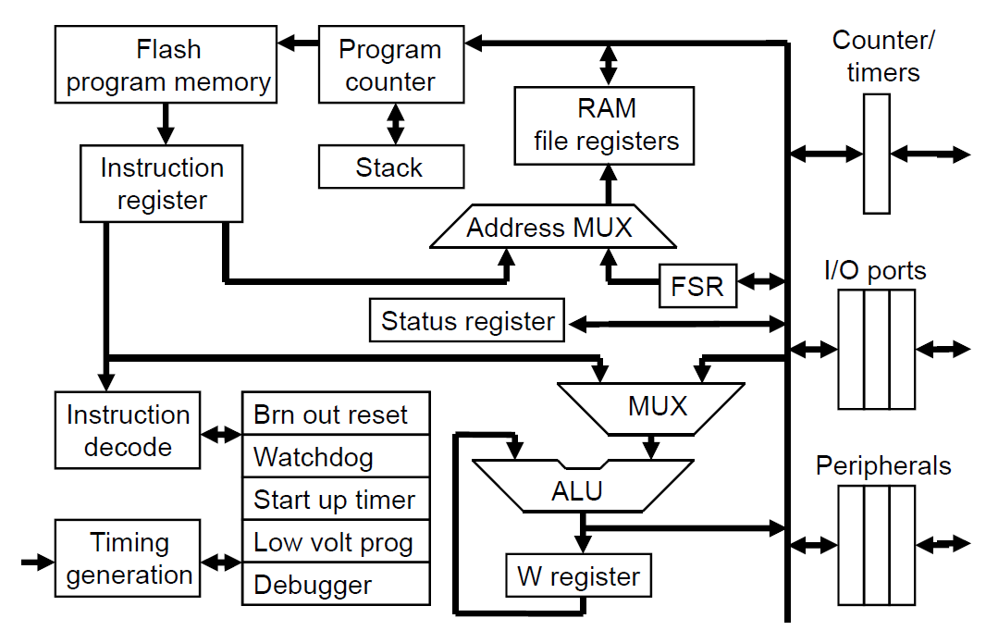
PIC18F: Controller Architecture

Slide 3
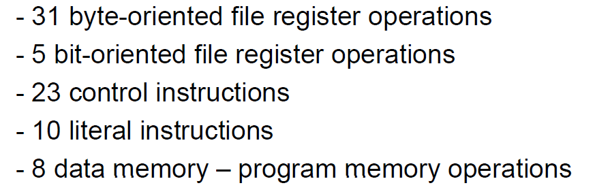
PIC18F: Instruction set grouping

Slide 4
PIC18F: Notational convention
WREG
W Register
FREG
File Register (any register location from GPR Bank 0 / SFR)
[X]
Contents of register X
Examples:
[WREG] = 0x02 ↔ WREG’s contents become 0x02
[0x20] = 0x34 ↔ RAM File Register 0x20 content becomes 0x34
[X] = [Y] ↔ Contents of Y are copied into X

Slide 5
Byte-oriented instructions

Slide 6
PIC18F: Instructions – byte-oriented move
Move operations – data movement / copy
MOVLW 0x20
Move 0x20 into WREG
Effect: [WREG] = 0x20
MOVWF 0x20
Move [WREG] to 0x20
Effect: [0x20] = [WREG]
0x--
WREG
0x20
WREG
GPR0
GPR0
0x--
0x20
0x23
0x20
0x23
WREG
0x23
WREG
0x--
0x21
0x--
0x21

Slide 7
PIC18F: Instructions – register set/clear
SETF
Set all bits of FREG to 1
Example: SETF 0x20
Effect: [0x20] = (1111 1111)₂ = (255)₁₀ = 0xFF
CLRF
Clear all bits of FREG
Example: CLRF 0x20
Effect: [0x20] = (0000 0000)₂ = (0)₁₀ = 0x00
0x--
0x20
0xFF
0x20
0x--
0x20
0x00
0x20

Slide 8
PIC18F: Instructions – byte-oriented add
Add operations
ADDLW 0x20
Add 0x20 to WREG
Effect: [WREG] = [WREG] + 0x20 = 0x11 + 0x20 = 0x31
ADDWF 0x20
Add [WREG] and [0x20]
Effect: RESULT = [WREG] + [0x20]
0x11
WREG
0x31
WREG
GPR0
GPR0
0x42
0x20
0x??
0x20
0x11
WREG
0x??
WREG
0x--
0x21
0x--
0x21
RESULT = 0x11 + 0x42 = 0x53

Slide 9
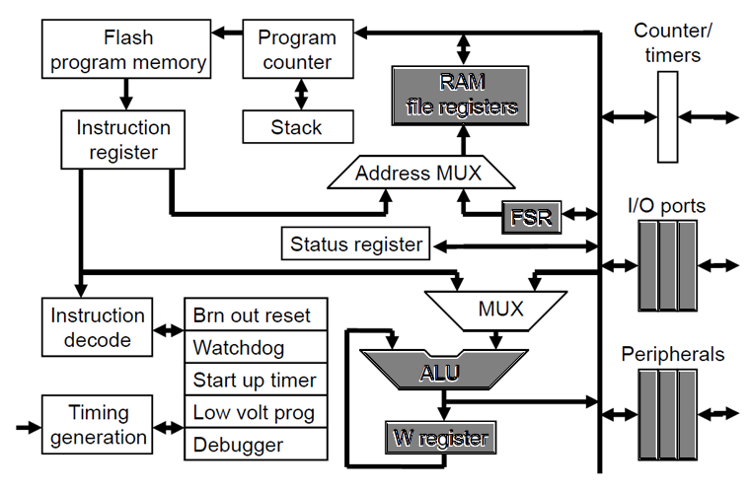
PIC18F ALU: Connections

Slide 10
PIC18F: Destination Control
ALU result destination: Either WREG or FREG
Indicated by destination flag at the instruction’s end
Example: ADDWF 0x20, F => Destination is FREG (0x20)
Example: ADDWF 0x20, W => Destination is WREG
GPR0
GPR0
0x42
0x20
0x53
0x20
0x11
WREG
0x11
WREG
0x--
0x21
0x--
0x21
GPR0
GPR0
0x42
0x20
0x42
0x20
0x11
WREG
0x53
WREG
0x--
0x21
0x--
0x21

Slide 11
PIC18F: Playing with destination control
MOVLW 0x10
MOVWF 0x20
MOVLW 0x30
ADDWF 0x20,W
ADDWF 0x20,F
[WREG] = 0x10
[0x20] = 0x10
[WREG] = 0x30
[WREG] = ?
[0x20] = ?
[WREG] = ?
[0x20] = ?
MOVLW 0x10
MOVWF 0x20
MOVLW 0x30
ADDWF 0x20,F
ADDWF 0x20,W
[WREG] = 0x10
[0x20] = 0x10
[WREG] = 0x30
[WREG] = ?
[0x20] = ?
[WREG] = ?
[0x20] = ?

Slide 12
PIC18F: More byte-oriented instructions
Data movement
MOVF
MOVFF
Arithmetic
ADDWFC
SUBWF, SUBWFB
SUBFWB
Logical
ANDWF, IORWF, XORWF

Slide 13
PIC18F: Instructions – more moves
MOVF 0x20, W
Move contents of 0x20 into WREG
MOVFF 0x20, 0x40
Move content of 0x20 to 0x40
GPR0
GPR0
0xAB
0x20
0xAB
0x20
0x--
WREG
0xAB
WREG
0x--
0x21
0x--
0x21
GPR0
GPR0
0xCD
0x20
0x--
0x40
0xCD
0x20
0xCD
0x40
0x--
0x21
0x--
0x41
0x--
0x21
0x--
0x41

Slide 14
PIC18F: Instructions – add overflow
What if ADDWF results in overflow (a carry)?
Example: ADDWF 0x20, where [WREG] = 0xFF, [0x20] = 0x02
1
0xFF
+ 0x02
---------
0x101
Result = 0x101 (257)₁₀ : greater than 8-bits!
Where does the extra 1 go?
It goes into the CARRY bit of the STATUS REGISTER
Final Result = 0x01, Carry bit = 0x1
Hexadecimal add:
0xF + 0x1 = 0x10
0xF + 0x2 = 0x11

Slide 15
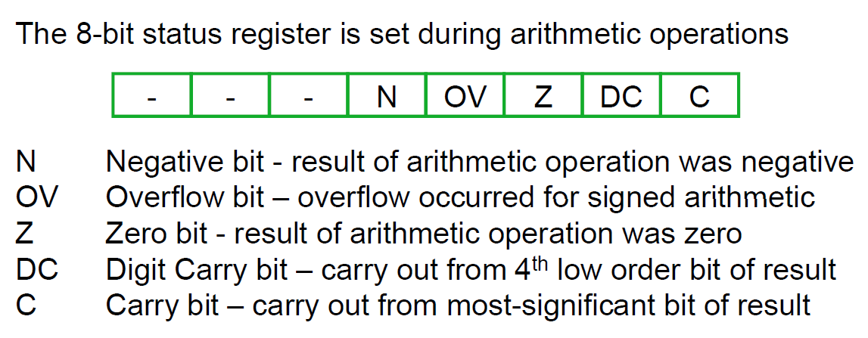
PIC18F ALU: Status Register
C = Carry bit for addition, borrow bit for subtraction

Slide 16
PIC18F: Instructions - add with carry
To ensure CARRY bit is taken care of:
ADDWFC (ADDWF with Carry)
Example: ADDWFC 0x20 for [WREG] = 0x01, [0x20] = 0x02, C = 1
0x01 [WREG]
+0x02 [0x20]
+0x01 [Carry bit]
--------
0x04 Result
Note: ADDWFC uses CARRY bit from previous operation

Slide 17
Mathematics: Addition, Subtraction
Addition:
a + b = b + a
Hence, addition is called commutative – order does not matter
So an ADDWF / ADDWFC suffices
Subtraction
a – b ≠ b – a
Thus, subtraction is non-commutative – order does matter!
So, PIC18F has separate instructions for (a-b) and (b-a)!
SUBWFB and SUBFWB

Slide 18
PIC18F: Instructions - subtraction
SUBLW (subtraction with W)
Example: SUBLW 0x20
Effect: [WREG] = 0x20 – [WREG]
SUBWF (plain subtraction)
Example: SUBWF 0x20, F
Effect: [0x20] = [WREG] – [0x20]
SUBWFB (subtraction with borrow)
Example: SUBWFB 0x20, F
Effect: [0x20] = [WREG] – [0x20] – C (Borrow flag)
SUBFWB (reverse subtraction with borrow)
Example: SUBFWB 0x20, F
Effect: [0x20] = [0x20] – [WREG] – C (Borrow flag)

Slide 19
Mathematics: Multiplication
Multiplication:
a * b = b * a
Hence, multiplication is commutative – order does not matter
The problem with multiplication – overflow!
8-bit number * 8-bit number
Gives a 16-bit answer – product
Example: 255 * 255 = 2⁸ * 2⁸ = 2⁽⁸⁺⁸⁾ = 2¹⁶ = 65036
Can’t fit in any 8-bit register
Hence, the need for a register pair PRODH:PRODL

Slide 20
Mathematics: Division
Division:
a / b ≠ b / a
Hence, division is non-commutative – order does matter!
But division is much more complicated!
Corner cases
1 / 2 → Decimal fraction (0.50)
1 / 3 → Repeating decimal fraction(0.33333…)
1 / 7 → Repeating decimal sequence fraction (0.142857142857…)
1 / 0 → ∞
0 / 0 → ?
Certainly not fixed-point!

Slide 21
PIC18F: Instructions - multiplication
MULLW (multiplication with W)
Example: MULLW 0xFF for [WREG] = 0xFF
Effect: [PRODH]:[PRODL] = [WREG] * 0xFF
Result: 0xFF * 0xFF = 255 * 255 = 65025 = 0xFE01
SFR
PRODH
PRODL
0xFF
WREG
0xFE
0x01

Slide 22
PIC18F: Instructions - multiplication
MULWF (multiplication with FREG)
Example: MULWF 0x20 for [WREG] = 0x02, [0x20] = 0x01
Effect: [PRODH]:[PRODL] = [WREG] * [0x20]
GPR0
SFR
0x01
0x20
PRODH
PRODL
0x02
WREG
0x--
0x21
0x00
0x02
Result: 0x02 * 0x01 = 0x0002

Slide 23
Logical instructions

Slide 24
PIC18F: Instructions – logical AND(L)
ANDLW
8-bit AND of [WREG] and Data
Example: ANDLW 0x12 for [WREG] = 0x02
0000 0010 [WREG]
0001 0010 0x12
--------------
0000 0010 Result, goes into WREG
Effect: [WREG] = 0x02

Slide 25
PIC18F: Instructions – logical AND(F)
ANDWF
8-bit AND of [WREG] and [FREG]
Example: ANDWF 0x20, F for [WREG] = 0x02, [0x20] = 0x12
0000 0010 [WREG]
0001 0010 [0x20]
--------------
0000 0010 Result, goes into 0x20
Effect: [0x20] = 0x02

Slide 26
PIC18F: Instructions – logical OR(L)
IORLW
8-bit inclusive OR of [WREG] and Data
Example: IORLW 0x12, F for [WREG] = 0x02
0000 0010 [WREG]
0001 0010 0x12
--------------
0001 0010 Result, goes into WREG
Effect: [WREG] = 0x12

Slide 27
PIC18F: Instructions – logical OR(F)
IORWF
8-bit inclusive OR of [WREG] and [FREG]
Example: IORWF 0x20, F for [WREG] = 0x02, [0x20] = 0x12
0000 0010 [WREG]
0001 0010 [0x20]
--------------
0001 0010 Result, goes into 0x20
Effect: [0x20] = 0x12

Slide 28
PIC18F: Instructions – logical XOR(L)
XORLW
8-bit exclusive OR of [WREG] and Data
Example: XORLW 0x12, F for [WREG] = 0x02
0000 0010 [WREG]
0001 0010 0x12
--------------
0001 0000 Result, goes into WREG
Effect: [WREG] = 0x10

Slide 29
PIC18F: Instructions – logical XOR(F)
XORWF
8-bit exclusive OR of [WREG] and [FREG]
Example: XORWF 0x20, F for [WREG] = 0x02, [0x20] = 0x12
0000 0010 [WREG]
0001 0010 [0x20]
--------------
0001 0000 Result, goes into 0x20
Effect: [0x20] = 0x10

Slide 30
PIC18F: Journey so far
Move
MOVLW, MOVWF, MOVF, MOVFF
Register setup
SETF, CLRF
Arithmetic (with and without carry/borrow)
ADDLW, ADDWF, ADDWFC
SUBLW, SUBWF, SUBWFB, SUBFWB
MULLW, MULWF
Logical
ANDLW, ANDWF
IORLW, IORWF
XORLW, XORWF

Slide 31
Number crunching instructionS!

Slide 32
PIC18F: Some more instructions!
Negation
COMF
NEGF
Rotate / Shift
RLCF, RLNCF
RRCF, RRNCF
Swap
SWAPF
Increment, Decrement
INCF, DECF

Slide 33
PIC18F: Instructions - negation
COMF Binary complement (1→0, 0→1) of FREG’s content Also called one’s complement Example: COMF 0x20, F for [0x20] = 0x32 0x3 0x2 0xC 0xD 0011 0010 becomes 1100 1101 Result: [0x20] = 0xCD
NEGF Negation: Take the two’s complement of contents of FREG Example: NEGF 0x20, F for [0x20] = 0x32 0x3 0x2 0xC 0xE 0011 0010 becomes 1100 1110 Result: [0x20] = 0xCE

Slide 34
PIC18F: Instructions – rotate left
RLCF
Rotate Left with Carry bit the contents of FREG
Example: RLCF 0x20, F for [0x20] = 0x20, C = 1
C=1 becomes C=0
0010 0000 0100 0001
Result: [0x20] = 0x41
RLNCF
Rotate Left with No Carry bit the contents of FREG
Example: RLNCF 0x20, F for [0x20] = 0x20, C = 1
C=1 becomes C=1
0010 0000 0100 0000
Result: [0x20] = 0x40

Slide 35
PIC18F: Instructions – rotate right
RRCF
Rotate Right with Carry bit the contents of FREG
Example: RRCF 0x20, F for [0x20] = 0x20, C = 1
C=1 becomes C=0
0010 0000 1001 0000
Result: [0x20] = 0x90
RRNCF
Rotate Right with No Carry bit the contents of FREG
Example: RRNCF 0x20, F for [0x20] = 0x20, C = 1
C=1 becomes C=1
0010 0000 0001 0000
Result: [0x20] = 0x10

Slide 36
Mathematics: Rotate/Shift for power of 2
What does shift right/left mean? Let’s take 4 (power of 2)
For 1-bit shift:
For 2-bit shift:
For n-bit shift:
 | Binary | Decimal
Original | 0100 | 4
Shift left by 1-bit | 1000 | 8
Shift right by 1-bit | 0010 | 2
Shift left ≡ “multiply by 2” | Shift right ≡ “divide by 2”
Shift left ≡ multiply by 4 (2²) | Shift right ≡ divide by 4 (2²)
Shift left ≡ multiply by 2^{n} | Shift right ≡ divide by 2^{n}

Slide 37
PIC18F: Instructions – swap
Digital definitions
Thus, 1 byte = 2 nibbles = 8 bits
SWAPF
Swap the nibble contents of FREG
Example: SWAPF 0x20, F for [0x20] = 0x34
0011 0100 becomes 0100 0011
Result: [0x20] = 0x43
Bit | Nibble | Byte
1-bit | 4-bits | 8-bits

Slide 38
PIC18F: Instructions – add/subtract 1
INCF
Increment (add 1) to contents of FREG
Example: INCF 0x20, F for [0x20] = 0x12
Effect: [0x20] = 0x12 + 0x01 = 0x13
DECF
Decrement (subtract 1) from contents of FREG
Example: DECF 0x20, F for [0x20] = 0x12
Effect: [0x20] = 0x12 – 0x01 = 0x11
Preferred instructions for loops and counters

Slide 39
PIC18F: Concept of “skip”
Skip means
Jump over next instruction
Usually conditional
If condition is TRUE
Perform the skip
Else
Do not perform the skip
Leads to compact code
Code memory
If skip is not performed
Execute n, n+1, etc
If skip is performed
Execute n, then n+2
n+1 not executed
Skip inst^{n}.
Instruction n
Instruction n+1
Instruction n+2

Slide 40
PIC18F: Skip conditions
Example conditions for skips
Zero flag – most popular
SZ (skip if zero) SNZ (skip if not zero)
Instructions: INCFSZ, DECFSZ INFSNZ, DCFSNZ
Equality based
SEQ (skip if equal), SGT (skip if greater than), SLT (skip if less than)
Instructions: CPFSEQ, CPFSGT, CPFSLT
Bit condition based
SC (skip if clear), SS (skip if set)
Instructions: BTFSC, BTFSS

Slide 41
PIC18F: Instructions – skipful DEC
DECFSZ
Decrement FREG contents
Save the result
Skip next instruction if result of increment is zero
DECFSZ 0x20, F
Case 1: [0x20] = 0x05
Result: [0x20] = ?
Case 2: [0x20] = 0x01
Result: [0x20] = ?
Code memory
Execution sequence:
Case 1:
??
Case 2:
??
DECFSZ 0x20, F
Instruction n
MOVLW 0x0
Instruction n+1
SUBWF 0x30, W
Instruction n+2

Slide 42
PIC18F: Instructions – skipful INC
INFSNZ
Increment FREG contents
Save the result
Skip next instruction if result of increment is not 0
INFSNZ 0x20, F
Case 1: [0x20] = 0x10
Result: [0x20] = ?
Case 2: [0x20] = 0xFF
Result: [0x20] = ?
Code memory
Execution sequence:
Case 1:
??
Case 2:
??
INFSNZ 0x20, F
Instruction n
MOVLW 0x0
Instruction n+1
SUBWF 0x30, W
Instruction n+2

Slide 43
Bit-oriented instructions

Slide 44
Industry: Motivation for bit-wise instruction
Lower pin count:
Pin real estate in the embedded world is expensive
Low-end devices (sensors) come in 1/2/3-pin forms
Using a byte is overkill
Hardware – pin level
Why waste an 8-pin port for interacting with a 1/2/3 pin sensor?
Hardware – register-level
Why use an 8-bit register when you need less bits?
Software – code level
Why use a byte-oriented instruction
When you could do with a bit-oriented one?!

Slide 45
PIC18F: Instructions – bit-wise, simple
Syntax: Bxx FREG, n (0 ≤ n ≤ 7)
BSF
Bit Set – set a particular bit in an FREG
Example: BSF 0x20, 0 for [0x20] = 0x12
Result: [0x20] = 0001 0011 = 0x13
BCF
Bit Clear – clear a particular bit in an FREG
Example: BCF 0x20, 4 for [0x20] = 0x12
Result: [0x20] = 0000 0010 = 0x02
0001 0010
0x20
0001 0011
0x20
0001 0010
0x20
0000 0010
0x20

Slide 46
PIC18F: Instructions – bit-wise, simple
BTG
Bit toggle – toggle a particular bit in an FREG
Example: BTG 0x20, 3 for [0x20] = 0x12
Point to note in bit-wise instructions:
Only the bit mentioned is affected
Other bits stay as they are!
0001 0010
0x20
0001 1010
0x20
Result: [0x20] = 0001 1010 = 0x1A

Slide 47
PIC18F: Instructions – bit-wise, skipful (S)
BTFSS FREG, n
Bit Test FREG’s nth bit
Skip if it is Set
BTFSS 0x20, 0
Case 1: [0x20] = 0x01
0000 0001
Case 2: [0x20] = 0x00
0000 0000
Code memory
Execution sequence:
Case 1:
??
Case 2:
??
BTFSS 0x20, 0
Instruction n
MOVLW 0x0
Instruction n+1
SUBWF 0x30, W
Instruction n+2

Slide 48
PIC18F: Instructions – bit-wise, skipful (C)
BTFSC FREG, n
Bit Test FREG’s nth bit
Skip if it is Clear
BTFSC 0x20, 0
Case 1: [0x20] = 0x01
0000 0001
Case 2: [0x20] = 0x00
0000 0000
Code memory
Execution sequence:
Case 1:
??
Case 2:
??
BTFSC 0x20, 0
Instruction n
MOVLW 0x0
Instruction n+1
SUBWF 0x30, W
Instruction n+2

Slide 49
PIC18F: Journey so far
Negation
COMF, NEGF
Rotate / shift
RLCF, RLNCF, RRCF, RRNCF
Swap
SWAPF
Increment, decrement (with and without skip)
INCF, DECF
INCFSZ, INFSNZ, DECFSZ, DCFSNZ
Bit-oriented (with and without skip)
BSF, BCF, BTG
BTFSS, BTFSC

Slide 50
PIC18F: Instructions – Part 1 summary
Move
Setup
Arithmetic
Logical
Negation
Rotate-shift
Swap
Concept of skip
Increment / decrement
Bit-oriented

Slide 51
Thank you!

